Slide 1

Election Management System
By: Wilson Quilli and Jason O’Neill

Slide 2
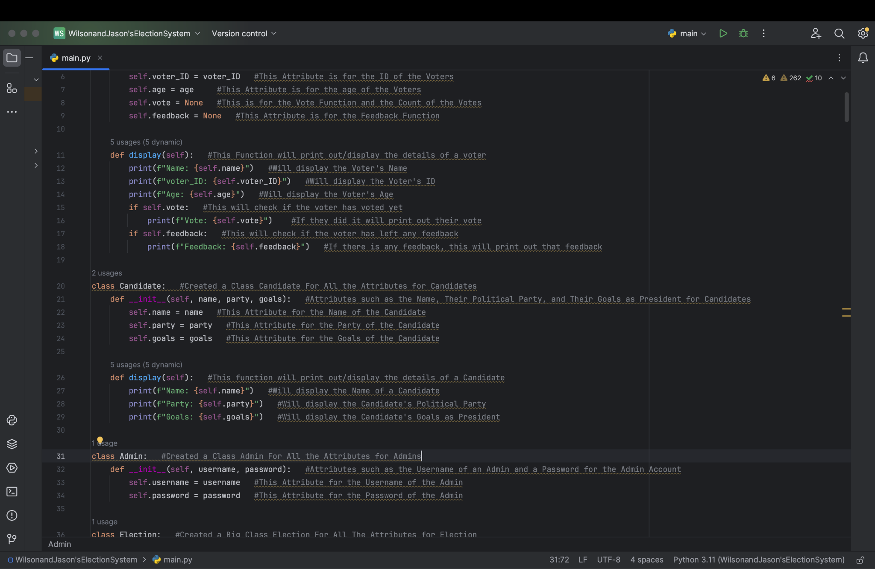
Description:
Our Project is designed to help run Elections with an easy-to-use system. We utilized several Classes throughout the code to store the attributes in.Some characteristics of our system is that it allows Admins to perform actions like adding a new Candidate or Voters to vote for that Candidate.

Slide 3
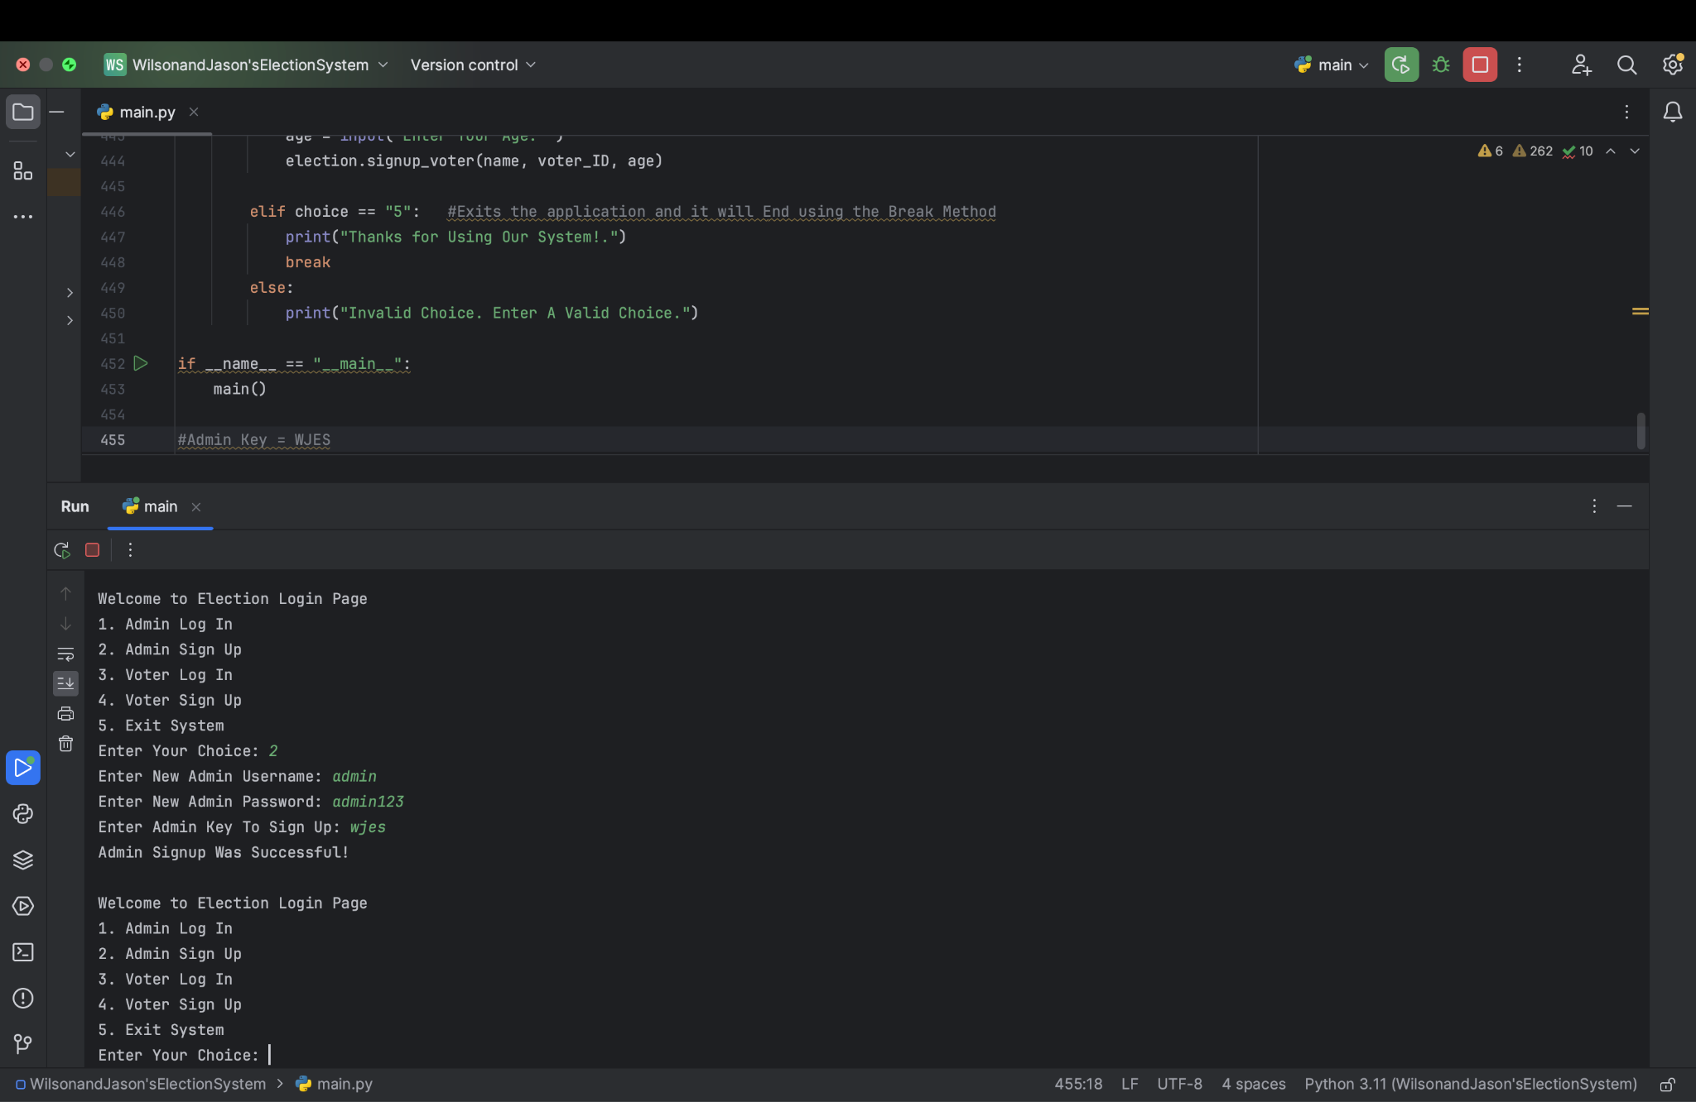
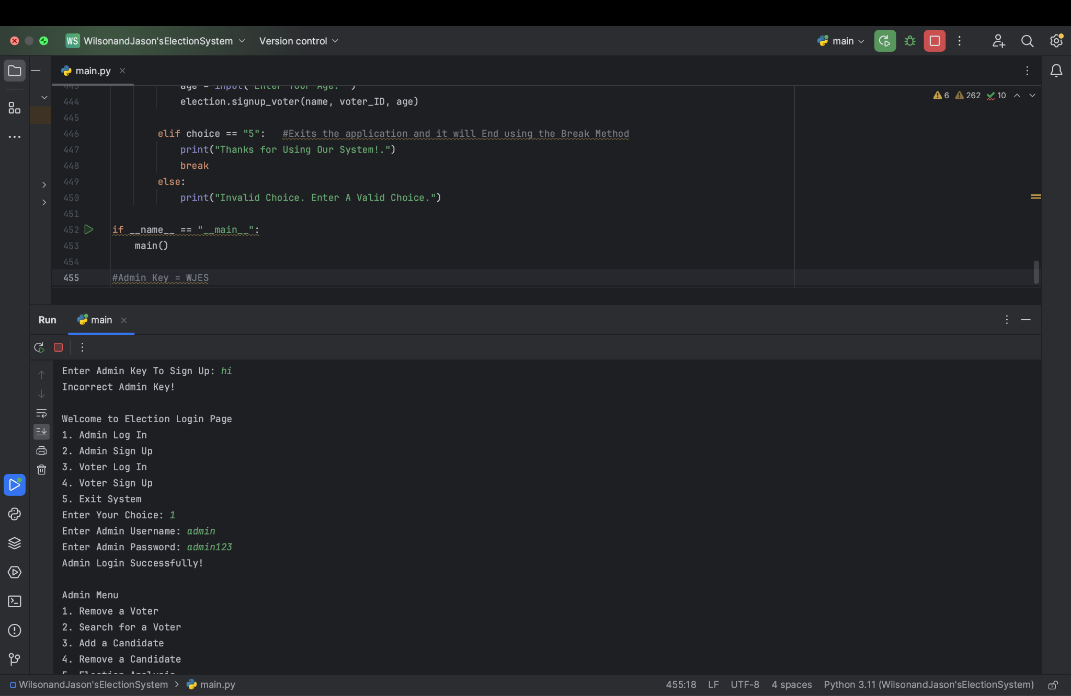

Project Goal:
Our goal with our Election Management System, was to create an easy-to-use system for admins and voters to use during Elections. We wanted it to be easy to sign up and login as an admin (with the correct key we set), and sign up and login as a voter (meeting the age requirements).

Slide 4

Instructions On How To Use
Start the Program
Sign Up as Either an Admin or Voter
After Creating an Account and Inputting the Correct Information, Log In
Once Logged In, Use the Menu, of the Option You Chose
Input the Number of the Desired Action in the Menu
Save Any Changes You Wish
Sign Out of the Menu
Exit/Close the Program with the Exit Feature in the Main Menu

Slide 5
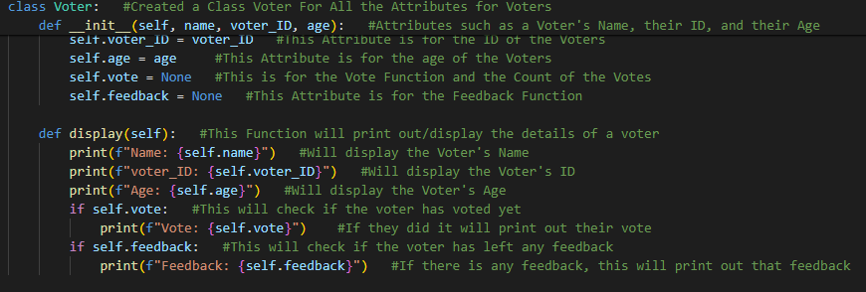
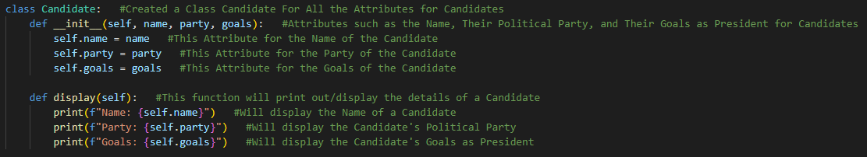
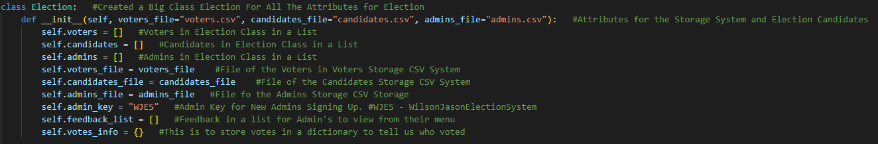
Structure of the Code
We designed our Project utilizing Object Oriented Programming. This can be shown through all the Classes (Admin, Voter, Candidate) used throughout the code. All of these classes encapsulate their own different attributes that are relevant to their specific functions But the “Core” of the System is the Election Class, which coordinates all of the Election’s interactions and controls the overall management of the system.

Slide 6

Applications of Class Learnings
Throughout our Project, we used multiple different learning methods/experiences from both our CMPSCI 131 and 132 Class.
Topics:
CSV Files/Storage System
Object Oriented Programming (OOP)
Encapsulation
Exception/Error Handling
Data Structures
Shown in Project:
We used CSV Files to create a storage system in our project to allow users to save any data they wish to and clear data as well. We both learned this in our CMPSCI 131 Class.
We learned a lot about OOP in our CMPSCI 132 and in our code, and in our system we used it in places like storing all feedback in a dictionary, a voter might’ve left.
Relating to OOP, in our system, Encapsulation can be seen in storing attributes in classes such as the Voter Class encapsulating a Voter’s Name and ID.
In our CMPSCI 131 class, we learned about Exception/Error Handling, by utilizing the Try and Except Method. This can be seen in our Admin Key Function for Sign Up.
In both, our CMPSCI 131 and 132 class, we learned about Data Structures and this can be seen in Lists, Dictionaries, and Tuples used throughout our system.

Slide 7


Conclusion
Our Election Management System leverages a variety of techniques learned in CMPSC 131 and CMPSC 132, including importing CSV files for data storage and implementing classes such as Candidate with attributes like name, political party, and presidential goals. Object-oriented programming principles can be seen throughout our system, such as encapsulation. We also utilized concepts from data structures and algorithms, the system performs tasks like candidate searching efficiently using data structures like Tuples and Lists. By incorporating file handling, exception handling, and user input, our system provides a user-friendly experience for both administrators and voters, and it can be seen as an example of how all the concepts we’ve learned this past semester can be applied to create real-world applications and projects.

